Slide 1
Instructions for educators
These slides are a complement to the full Substance Use Module located in the Ministry of Education's VLE.​ If you are using these slides, please be sure to also reference the instructions, additional notes/supports, and student materials found in the full module.​
For support accessing the VLE, please contact your board Technology-Enabled Learning and Teaching (TELT) consultant.
Notes:
Instructions for educators
We recommend printing the accompanying discussion guide in advance to support meaningful conversations during the session. Having the guide on hand will help structure dialogue, prompt reflection, and ensure key learning goals are addressed.

Slide 2
Grade 6
SUBSTANCE USE: Addictions and Related Behaviours
Notes:
This module introduces learning related to substance use, its range of effects, factors that influence substance use, as well as safe and healthy substance use choices that support our health and well-being. Students can also discuss, plan, and practice refusal skills and strategies, and learn the importance of seeking advice or help, should they need it.
Health and Physical Education: Understanding Health Concepts
D1.2 describe the range of effects associated with using cannabis, other drugs (e.g., prescription medications such as opioids; illicit opioids such as heroin; crack, cocaine, Ecstasy, crystal methamphetamine), and intoxicating substances (e.g., gas, glue)
Health and Physical Education: Personal Safety and Injury Prevention
D2.3 apply social-emotional learning skills (e.g., self-awareness and self-management skills, including anger management; communication skills, including listening skills and assertiveness skills) to promote positive interaction and avoid or manage conflict in social situations, in person or online (e.g., classroom groups, groups of friends, sports teams, school clubs, social media sites, online games)
Health and Physical Education: Making Healthy Choices
D2.4 use decision-making strategies and skills and an understanding of factors influencing drug use (e.g., personal values, peer pressure, media influence, curiosity, legal restrictions, cultural, religious, and spiritual teachings) to make safe personal choices about the use of drugs such as alcohol, tobacco, and cannabis, and about activities such as vaping, including the choice to abstain

Slide 3
Learning goals
We are learning to:
Explore the range of effects associated with various substances, including cannabis, vapour and tobacco products, and alcohol.
Identify factors that can influence our decisions about substance use.
Analyze and practice decision-making skills and refusal strategies to identify those that would work best for each of us.

Slide 4
Success criteria
How will we know we are achieving our learning goals?
What will it look like/sound like?
[co-create success criteria with students and record here]
Notes:
Co-develop success criteria with students using the following questions: “How will we know we are achieving our learning goals? What will it look like/sound like?”
For example:
I can...
Name a variety of substances and list their effects.
Demonstrate substance use decision-making skills and strategies that can support me.
Name ways to get advice or support related to substance use, if I need it.

Slide 5

Minds On
Exploring the facts
Notes:
Purpose: To support students in understanding substance use vocabulary and introduce students to the range of effects.
Note: the purpose of this activity is to provide key facts and information about substances, being cautious to avoid providing a level of detail that might increase comfort and familiarity with substances or encourage curiosity and use. Refer to the Educator Guide for additional information.
Teacher script: “Today we are going to talk about substance use and the type of substances that affect our brains and bodies. This means they can impact us mentally, physically, spiritually, and emotionally, as well as change the way we think, act, and feel. It’s important to talk about substances so we have the basic information we need to help us make informed decisions for ourselves. We’re going to start by learning about six types of substances and explore their effects.”

Slide 6

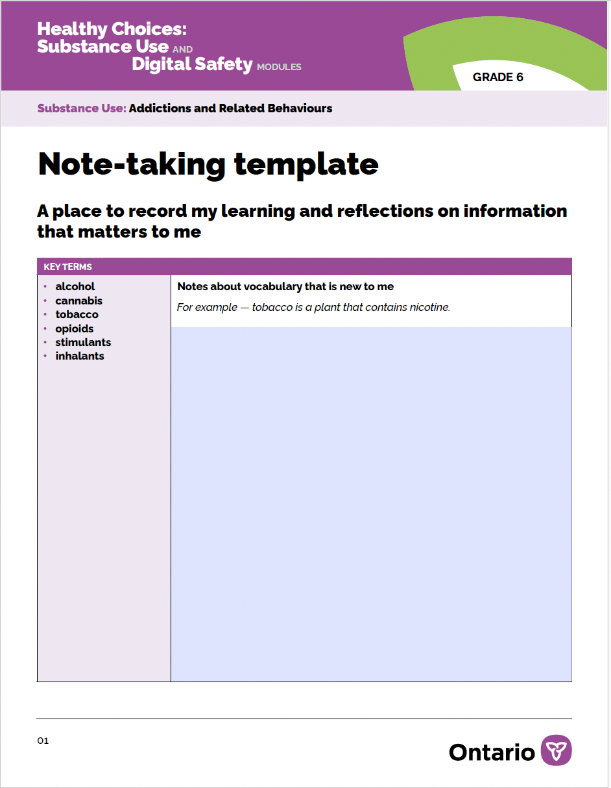
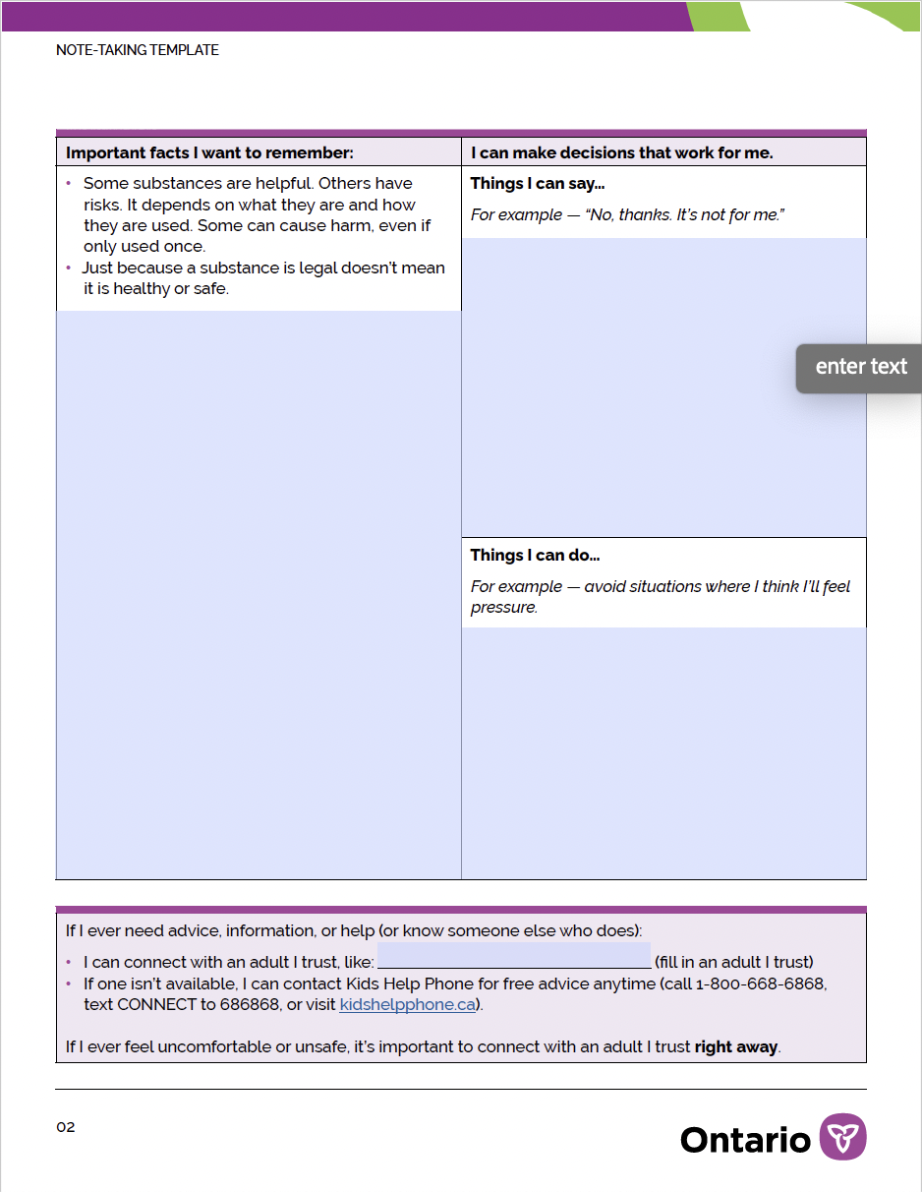
Note-taking template
Notes:
Start by distributing the note-taking template (paper or digital) to be used throughout the lesson. This will support students with their learning and allow them to record facts and ideas they may wish to refer to later. Encourage students to record their thinking in the way that works best for them (e.g., sketching or drawing, using assistive technology features such as voice to text, use of home language[s], etc.).

Slide 7
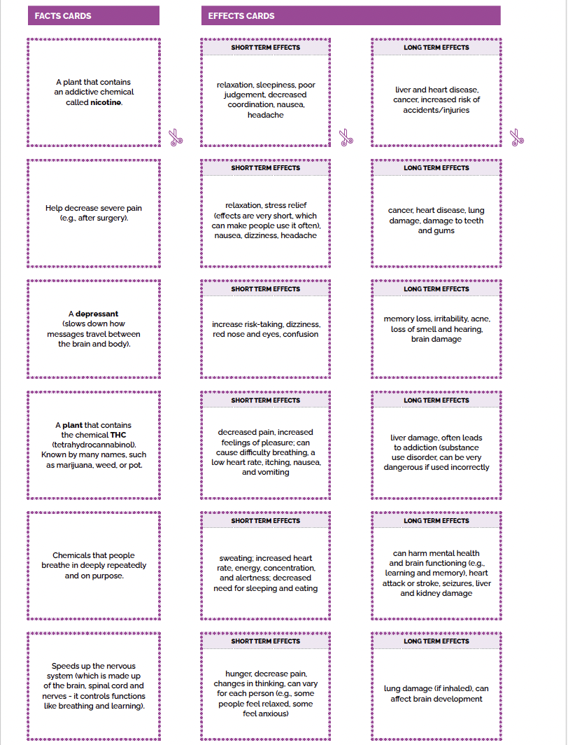
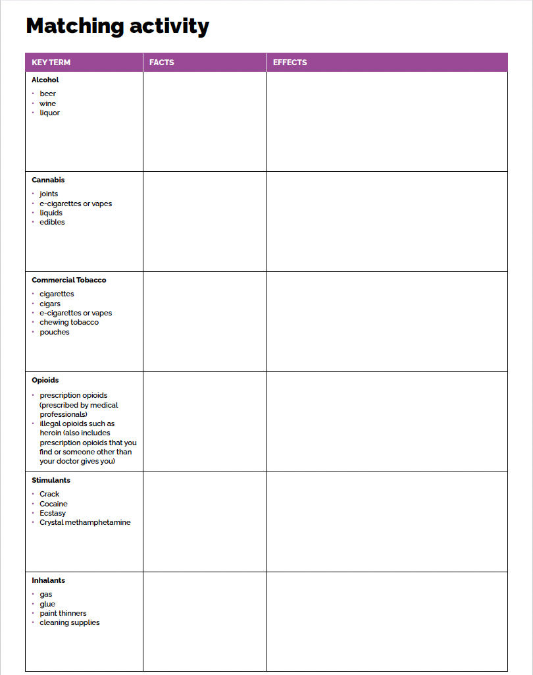
Matching activity
Notes:
Begin the Minds On sorting activity by dividing students into partners or small groups and provide them with a set of interactive cards and sorting chart (digital or paper copy).
Students will work together to match the information on the cards to the substances (alcohol, cannabis, tobacco, opioids, stimulants, inhalants) on the chart.
Invite students to share their answers and ensure their responses are accurate. Ask them what similarities/differences they noticed about the substances.
This is an opportunity to use the information in the discussion guide to expand students' knowledge. Post a completed chart in a shared learning space (physical or digital) for students to refer to throughout the lesson.

Slide 8
Reflection questions
How might the substances discussed affect our relationships?
Of the potential impacts we learned about, what are you most concerned about? Which might have the biggest influence on your decisions?
Notes:
1. Some themes that might emerge in response to the question about relationships are increased conflict with others (e.g., disagreements with parents/guardians), withdrawing from others, losing friendships, or having to be dishonest with others.
2. We learned that some substances could have positive effects, like relieving pain or helping us feel relaxed. We also learned about some risks for our bodies and minds.

Slide 9
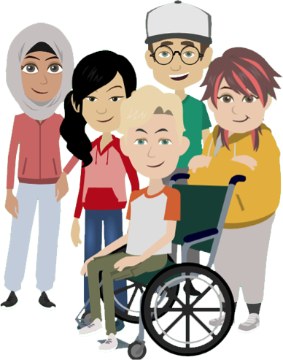
Action
Building a shared understanding
Notes:
Purpose: to learn more about students’ pre-existing knowledge and perceptions of substance use and to dispel some common myths and misconceptions related to substance use.
Use the slides to facilitate an interactive ‘True/False’ quiz. Refer to the Educator Discussion Guide for facilitation tips.
Follow-up the learning with a discussion using the reflection questions provided.

Slide 10


TRUE or FALSE?
Learning about substances
Interactive quiz
Notes:
Refer to the Educator Discussion Guide for more information to support this activity.

Slide 11
TRUE or FALSE? 1
You have to be 19 years old to use alcohol because it’s safe to use at that age.

Slide 12
You have to be 19 years old to use alcohol because it’s safe to use at that age.
Just because alcohol is legal when you turn 19, that doesn’t mean it is safe or healthy. There are guidelines to follow because it affects our brains and bodies. Under the age of 25, drinking alcohol or using other substances can be riskier, as the brain isn’t finished developing yet.
FALSE
Just because alcohol is legal when you turn 19, that doesn’t mean it is safe or healthy. There are guidelines to follow because it affects our brains and bodies. Under the age of 25, drinking alcohol or using other substances can be riskier, as the brain isn’t finished developing yet.
Notes:
Teacher script: “Just because you are old enough to use a substance doesn't mean that it is healthy or safe. It’s important to remember that even legal substances can harm our health. And if you ever find a vape or another substance, you can’t be sure what’s in it. Sometimes different substances get mixed together and you can’t even tell. This can make them much stronger than you expect, which is very unsafe.”

Slide 13
TRUE or FALSE? 2
Most teenagers in Ontario vape.

Slide 14
Most teenagers in Ontario vape.
FALSE
Sometimes social media, marketing, or seeing someone vape can make it seem like everyone is doing it, but most teens do not vape. Many teens decide not to vape for a variety of reasons.
Notes:
Teacher script: “Sometimes it can seem like vaping is common, but research shows that most Ontario students in grades 7-12 don’t vape. Students are also using fewer substances than they used to, and more students are choosing not to use any substances at all.”

Slide 15
TRUE or FALSE? 3
Just because my friend tried a vape, that doesn't mean it's safe for me.

Slide 16
Just because my friend tried a vape, that doesn’t mean it's safe for me.
TRUE
Everyone reacts to substances differently. The effects can depend on:
our health, age, and size
what substance is used
how often it is used
how much is used
how we are feeling in our body and mind
our environment
the way our brains and bodies work
Notes:
Teacher script: “Substances have varying social, mental, emotional, spiritual, and physical effects. Everyone reacts to them differently. Even when someone we know tries a substance, it’s not a guarantee that the same substance will affect us the same way. Some substances can harm us even if we only use them once. The effects can be different each time a substance is used, too.”

Slide 17
TRUE or FALSE? 4
Using alcohol or other addictive drugs is a choice. You can choose to stop using them at any time.

Slide 18
Using alcohol or other addictive drugs is a choice. You can choose to stop using them at any time.
FALSE
Substance use can cause chemical changes in the brain and body, which make it hard to stop.
This is called addiction.
Notes:
Teacher script: ”No one would choose to have an addiction, just like no one would choose to have any other type of illness. The information we’re learning today can help address stigma about substance use and addiction, which can help people seek support, if they need it.”

Slide 19
Reflection questions 1
Where do you and your peers tend to learn about substances like alcohol, cannabis, vapes, and tobacco? Is it from school, friends or family, the media, or somewhere else?
How can you decide if the information you are getting is true? What might help?

Slide 20
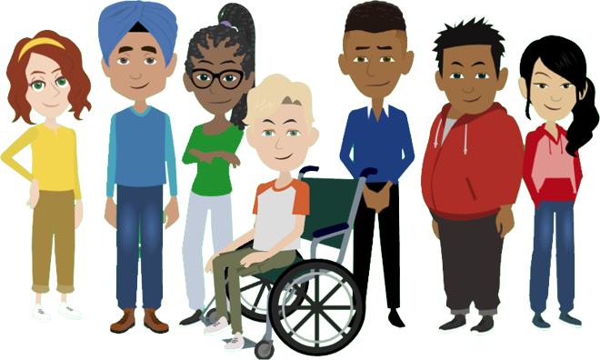
Consolidation
Making informed choices
Notes:
Purpose: to provide an opportunity to think about and practice substance use decision-making strategies.

Slide 21
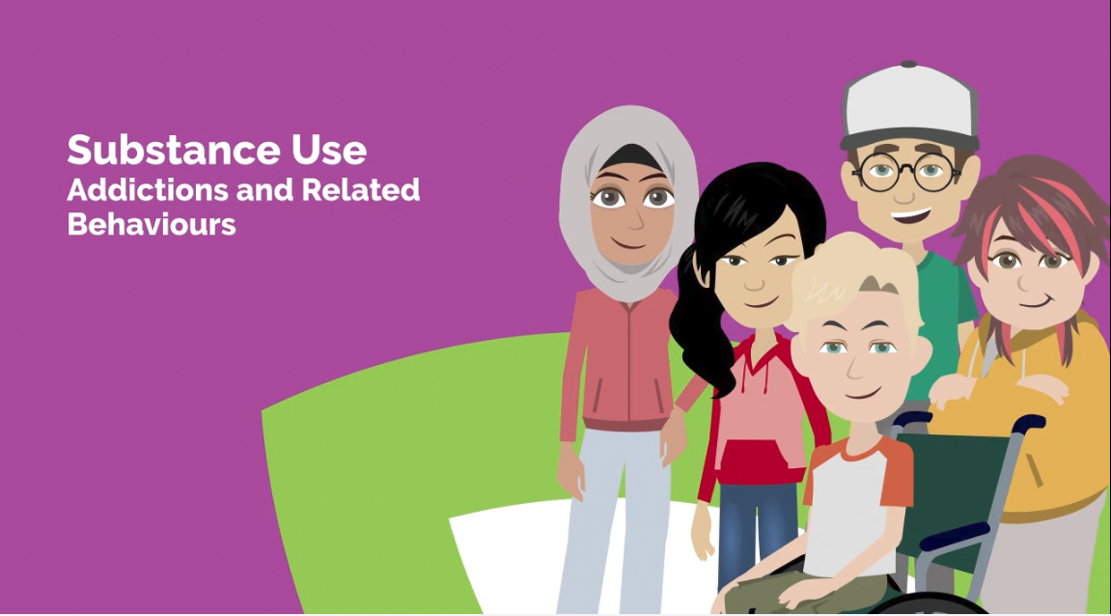
Healthy Choices: Substance Use, Modules for Grade 6 Students (video)
Notes:
Teacher script: “Now we are going to watch a video that shows a text conversation among students who are making decisions about vaping. During the video, we will pause and discuss the factors each student considers as well as how they communicate their decisions. Also, notice the refusal skills used by students. Refusal skills are a way to handle situations where you feel pressure to do something you don’t want to do or are unsure about.”
Video script adapted from: Ophea video - Vaping: Responding to Peer Influences

Slide 22
Refusal strategies
[record student ideas here]
Notes:
Teacher script: “There were some examples of refusal strategies shared in the video, and you may know many more. Practicing what you will say and do when you want to say no can help build your confidence and ability to action the choices that work for you. Remember, you can talk to a trusted adult if you are ever offered a substance and need help with what to do. ”
Do a quick re-cap of the strategies students noticed in the video and invite them to share any they might already use when they want to say no to something. Record these here or on an anchor chart (paper or digital) for students to refer to during this activity.
Many students will have existing strategies or will have noticed some in the video. Options you might also share include:
saying no/it’s not for you
leaving/walking away
delaying (e.g., saying, “I’ll think about it”)
making a joke
making an excuse (e.g., saying “I have to be home soon.”)
changing the subject/suggesting another activity

Slide 23
Questions for practice scenarios
In your scenario:
What might make someone want to try or not try the substance?
If someone chose not to try it, what could they say or do?
What if they needed help?
Notes:
Divide the class into partners or small groups and provide them with the scenario cards. Each group will select a scenario and then take turns responding to the guiding questions and trying out a refusal strategy. Remind students there is no best or ideal strategy. What fits may differ for each student. Groups repeat the process, as time allows.
Notes:
A scenario discussion guide is available for support.
When students role play/act out refusal skills, ensure no one plays the role of trying to get someone to use substances/offering substances.
Scenarios adapted from Ophea’s What Would I Do? and Niagara Public Health.

Slide 24


Scenarios - vaping
One day, a group of students invite you to hang out at the park after school. Excited to make new friends, you decide to go. When you get there, you notice everyone passing around a vape and using it. One of the students offers it to you. You worry no one will want to be friends if you don’t try the vape, and everyone is staring at you.
After school, you decide to head home with a friend. On the way, he takes out a vape and says he got it for the two of you. He holds out the vape to you. When you don’t take it, he says, “Everyone is doing it. Don’t you want to try it with me? I don’t want to do it alone.” You are curious about what it feels like and don’t want to let your friend down but aren’t sure you want to try it.

Slide 25



Scenarios - cannabis
You’re playing baseball with some kids from your neighbourhood during the summer. One of the older kids goes into his house and brings out some cold drinks and gummies that you think might have cannabis in them. He offers a gummy to you but doesn’t tell you what is in it. It looks like it might taste good, and he’s encouraging you to try it.
You and your friends are on the way to the park. One of your friends has some cannabis that they take out from their bag. They light the joint and try to pass it around, but everyone else seems uncomfortable with the cannabis. You are also on a street where you think people might see you.

Slide 26


Scenarios - alcohol
One night, you go to your friend’s house to watch a movie. Her parent/guardian is out for the evening. She brings out various bottles of alcohol and passes them around to everyone who is there. Everyone else tries it. Your friend says, “Your turn next. Come on! It’s amazing!” Everyone seems to be having fun, and you are starting to feel left out, but it’s a big decision to you.
You have had a tough week and are feeling tired and stressed. You have seen people in your favourite shows drink alcohol when they are stressed, and it always seems to make them feel better. You remember that your parent/guardian keeps some beer in the fridge and think you might be able to take some without them noticing. You want to feel better and aren’t sure what else to do.

Slide 27
Reflection questions 2
How can friends or peer pressure affect your decisions?
What helps you make choices that feel right for you, even if others disagree?
Who could help you if you feel unsure or pressured, and how could you help others?
Notes:
Bring the class back together for a debrief of the activity.
Prompt students to record any key learnings or reflections on their note-taking template that was distributed at the start of the lesson. Encourage students to reflect on the help-seeking information in the bottom box and fill in the name of a trusted adult. Ask students to think about where they will keep this page of information so that they have it if they need it.

Slide 28
We might need advice or help if...
We have questions or need more information about substances.
Our refusal skills and strategies aren’t working, and we need advice.
Substances are starting to have harmful effects on our lives.
Substances are starting to have harmful effects on someone we care about.
Notes:
Sometimes, even when we know information about substances and have refusal skills and strategies, we still need help. Students might need help for many reasons.

Slide 29
Signs we might need advice or help
Not being able to keep up with responsibilities at school or home.
Giving up activities that used to be important or enjoyable.
Changes in mood (e.g. feeling more irritable, anxious, or down than usual).
Changing friends.
Having difficulties with family members, friends, and peers.
Notes:
Teacher script: “Remember, there are many types of substances, each with a range of effects. Substance use becomes an issue when those effects start to cause harm. That might show up as changes in how you do at school, trouble getting along with others, not feeling as well as usual, or feeling unable to cut down or stop, even when you want to. If that ever happens, it’s time to talk to a parent, guardian, or another adult you trust for more support. If you know someone else who needs help, such as a friend, it’s important to reach out for help for them, too, even if you just need advice about what to do.”

Slide 30
How to find advice or help
Reach out to a trusted adult in your personal life, school, or community.
Contact a free helpline, like Kids Help Phone (available 24/7 in English, French, and other languages).
  Website: kidshelpphone.ca
  Phone: 1-800-668-6868
  Text CONNECT to 686868
Notes:
No matter what substance students might be concerned about, the first step is reaching out to a trusted adult in their personal lives, school, or community. They can also call or text a help line, like Kids Help Phone. This is an opportunity to help students identify school and community resources that support mental health problems and those relating to substance use. Consider posting information in your classroom and school in a variety of ways (e.g., on the back of bathroom stall doors or electronically on a website or shared class platform so students can access them privately).
Note: Addiction is among the most stigmatized of all health conditions. It’s important to talk about substance use in ways that reduce stigma and decrease barriers to seeking help. Additional information on supporting students is available in the Educator Guide.
Optional student resource: My Circle of Support – Student Help-Seeking Resource

Slide 31
Key learnings
It’s important to know the facts about a substance so we can make informed and healthy choices.
Refusal skills can help us feel confident and stay true to our substance use decisions.
There are people who can help if we have a concern about substance use.
Notes:
Substances can affect us mentally, emotionally, spiritually, and physically. Some substances can be more harmful than others. It’s important to know the facts about a substance so we can make informed and healthy choices.
Our personal choices about substance use can impact our health and well-being.
Knowing and practicing refusal skills can help us feel confident and stay true to our substance use decisions.
There are people in our school and community who can help if we have a concern about substance use.

Slide 32
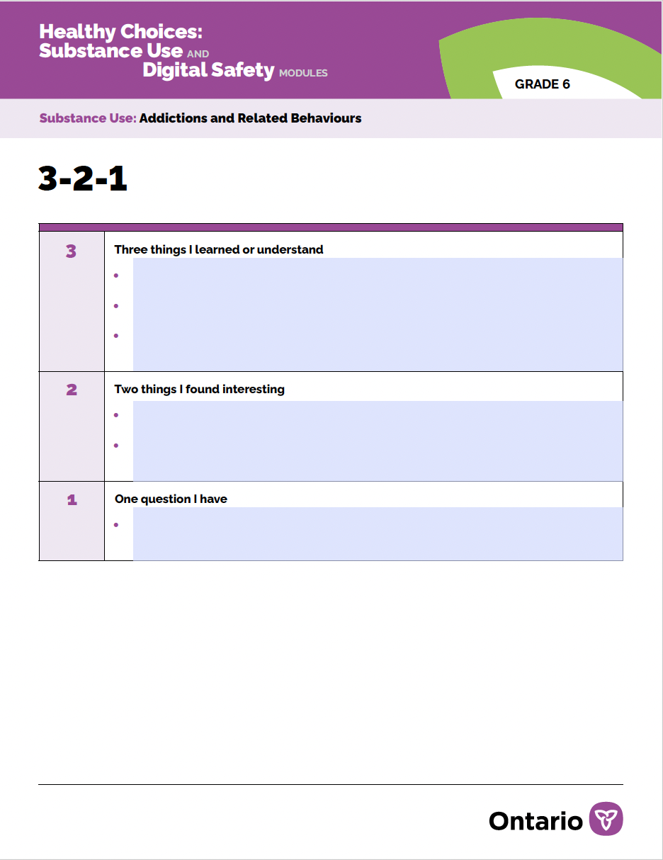
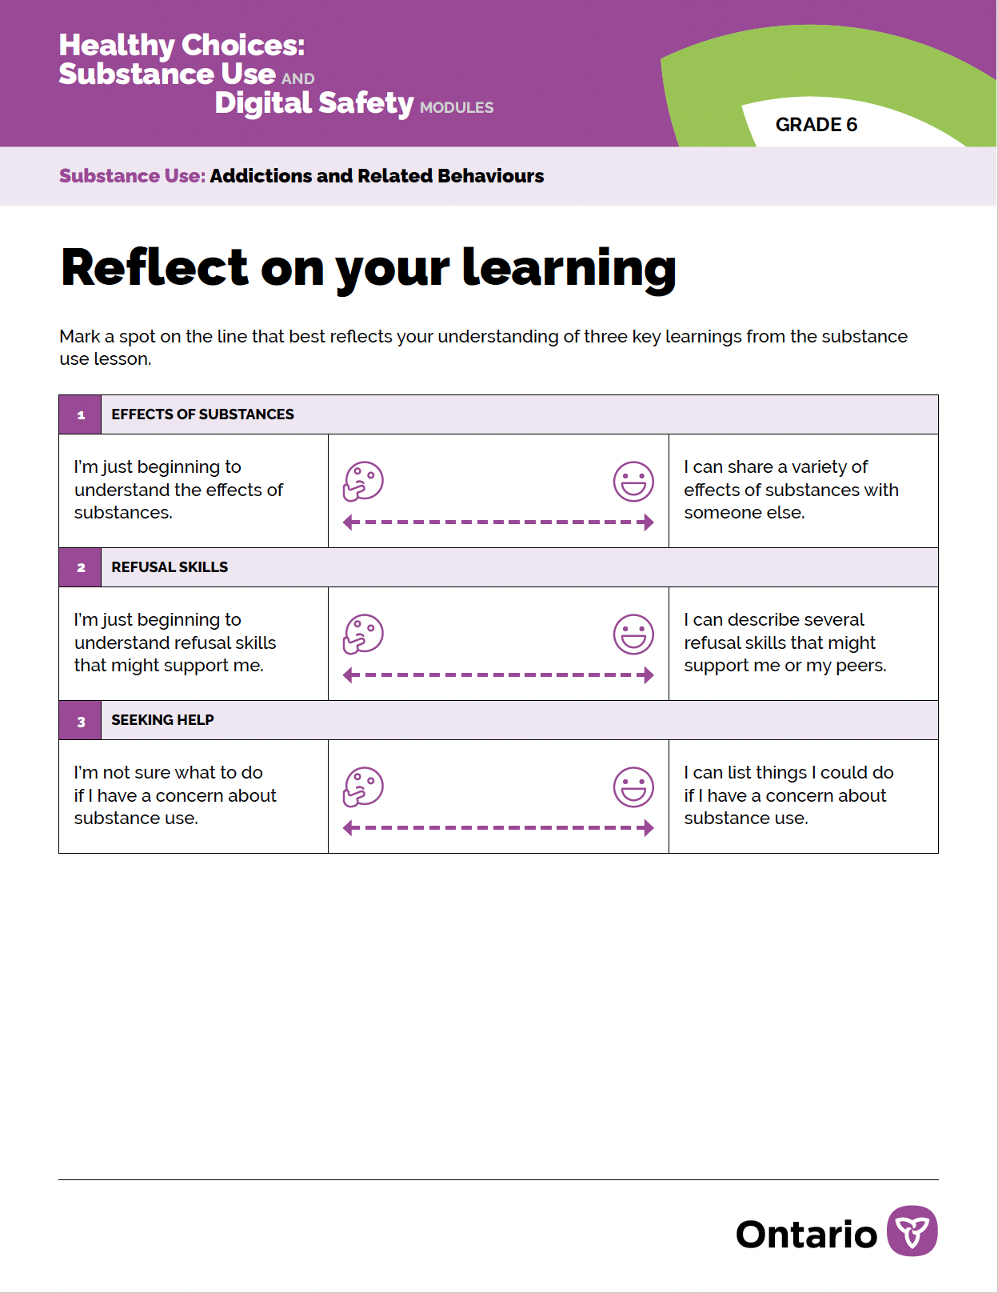
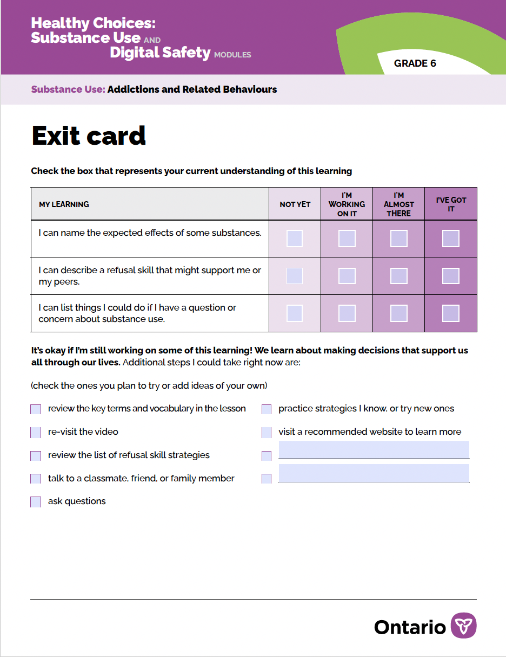
Assessment (optional)
Notes:
Slide is hidden because it is optional content.

Slide 33
Supportive transition
If you wish, refer to the Supportive Transitions Tip Sheet for a list of easy-to-use activities to help students transition to whatever is next in their day.
Two examples from that list have been embedded on the following slides.
Also, simple activities like going outside for a walk, playing a game or music that students enjoy, doing a random act of kindness, or providing extra time for students to complete an assignment are valuable, too!
Notes:
Instructions for educators.

Slide 34
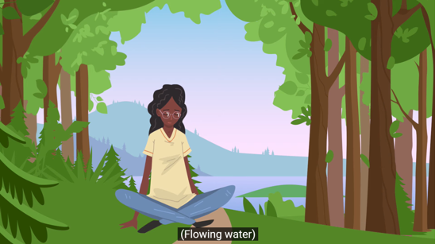
Finding Calm - Forest visualization (video)
Notes:
Slide is hidden because it is optional content.​

Slide 35
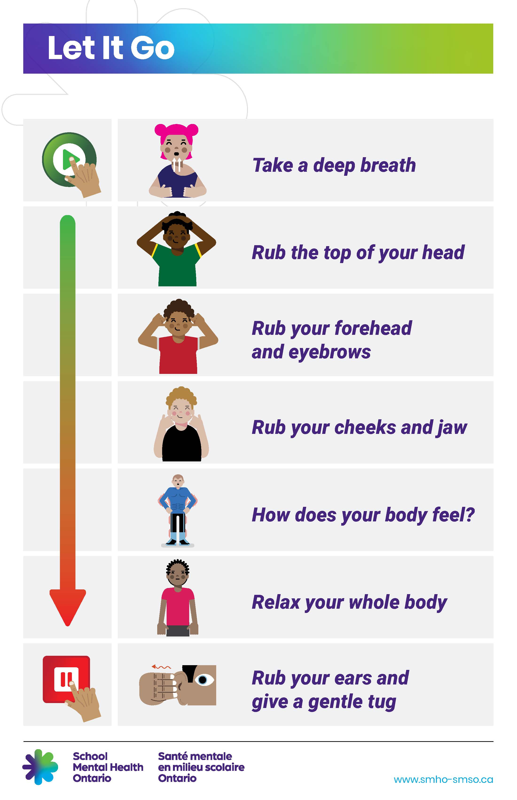



Click for audio
Notes:
Slide is hidden because it is optional content.​

